Slide 1
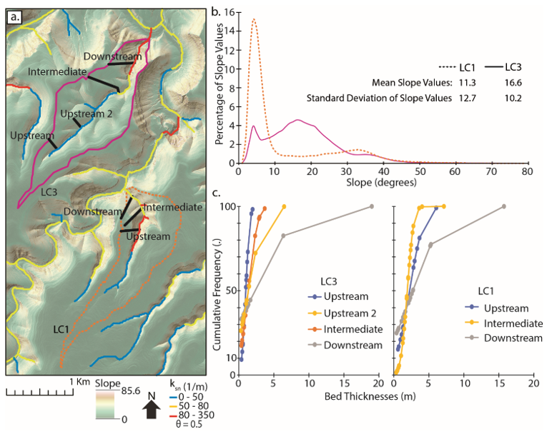

Slide 2
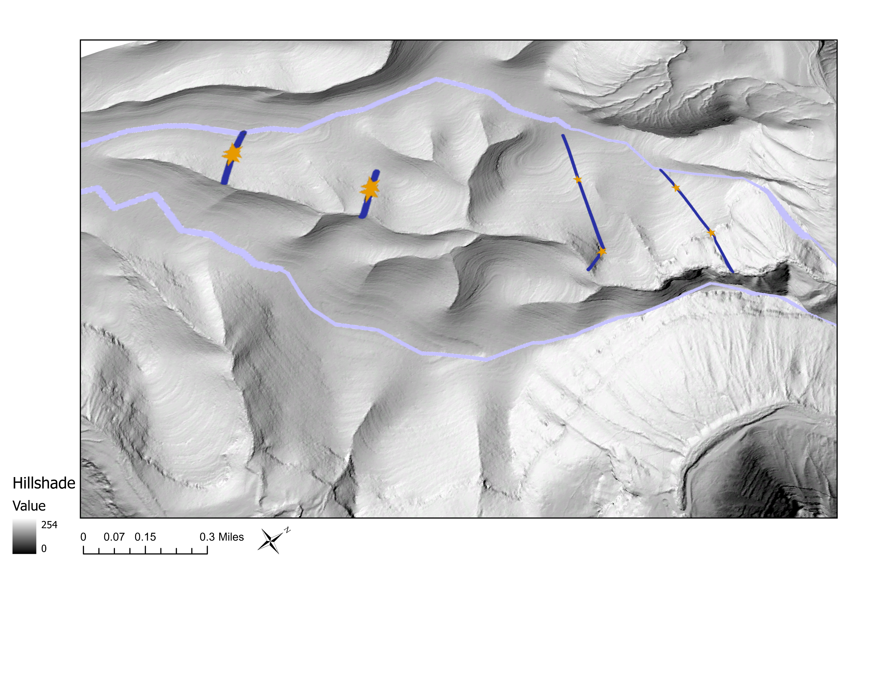
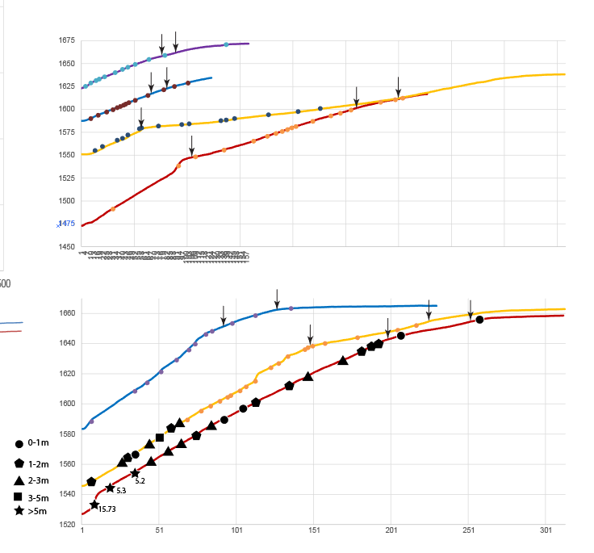
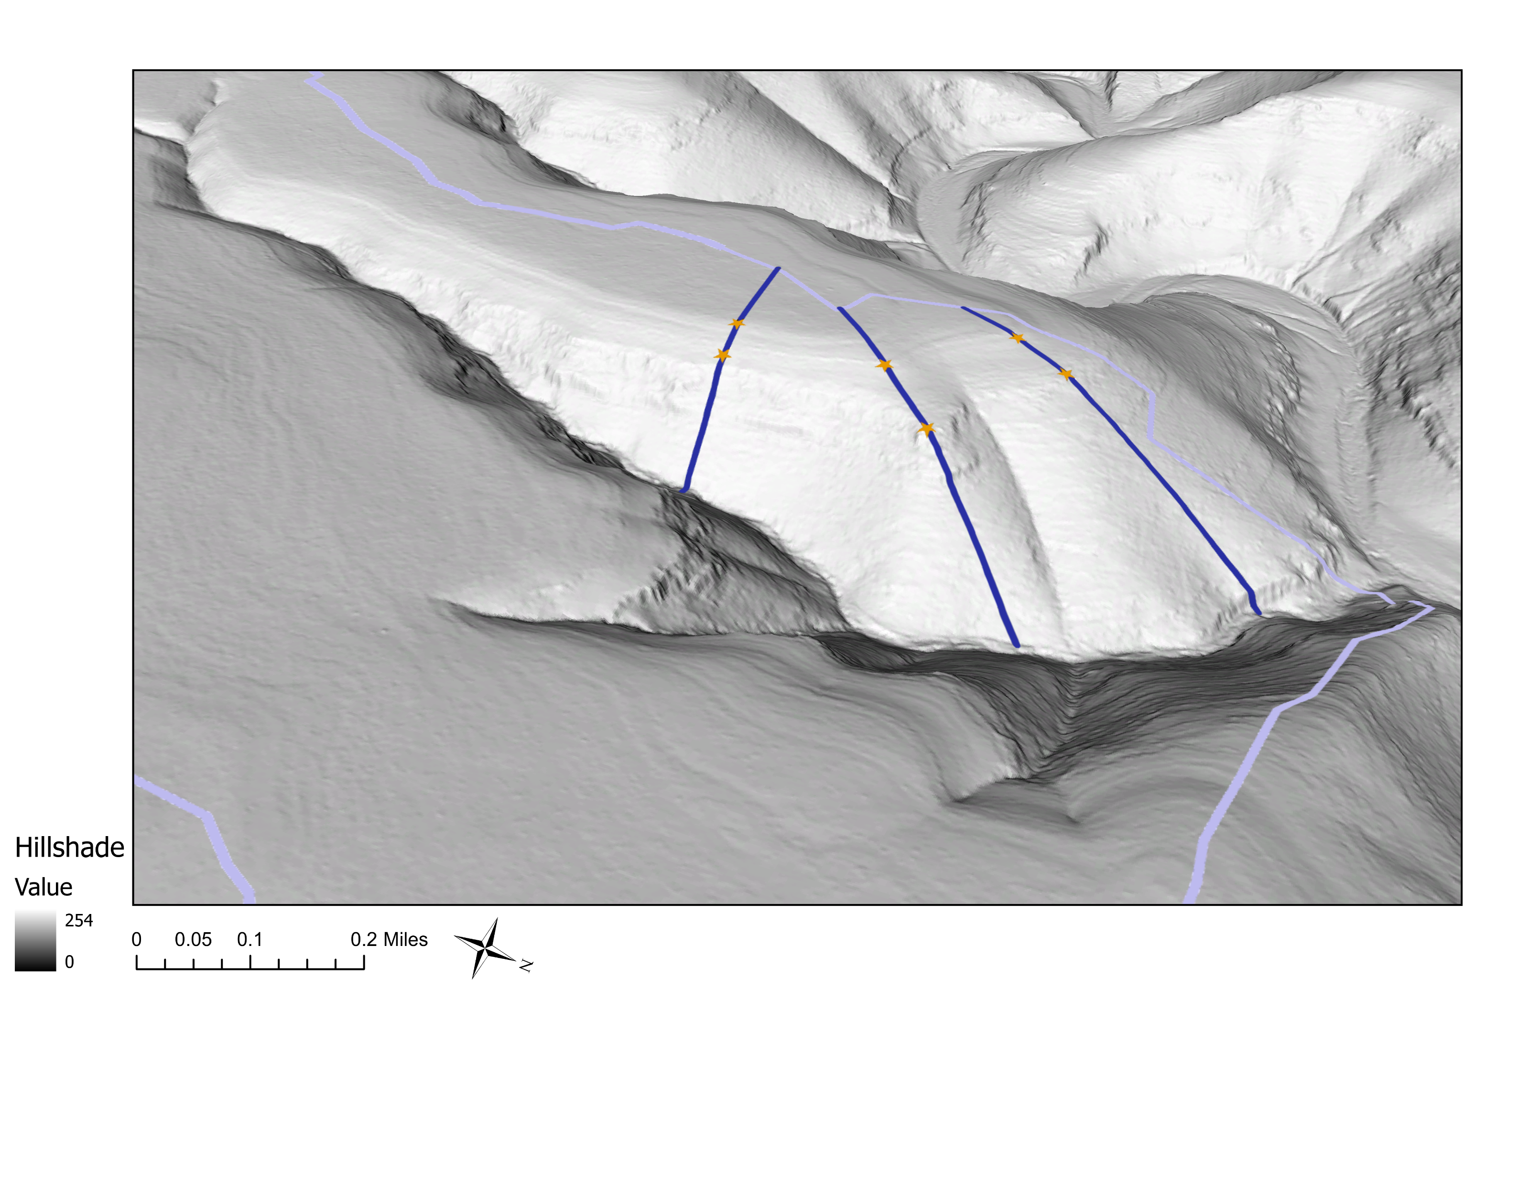

Slide 5
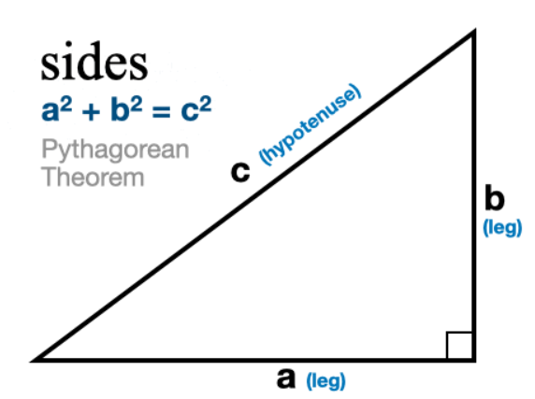

Slide 6
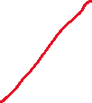
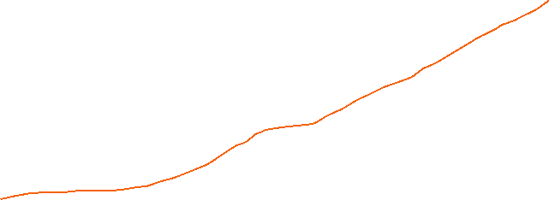

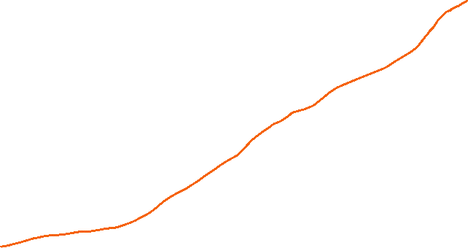


If the bed below the upper inflection is bigger = alpha2
If smaller = alpha1

Slide 9
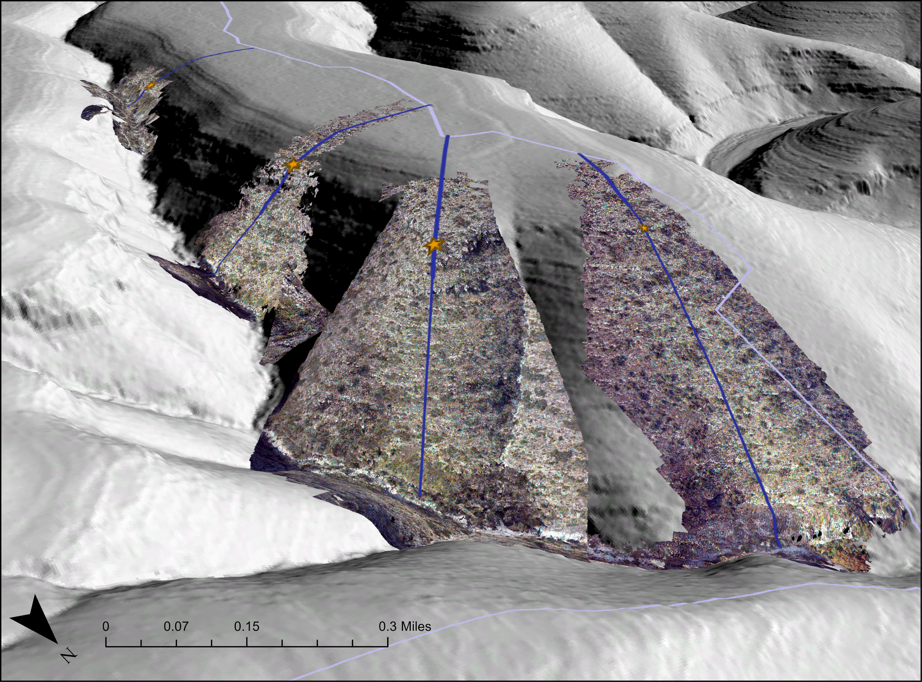
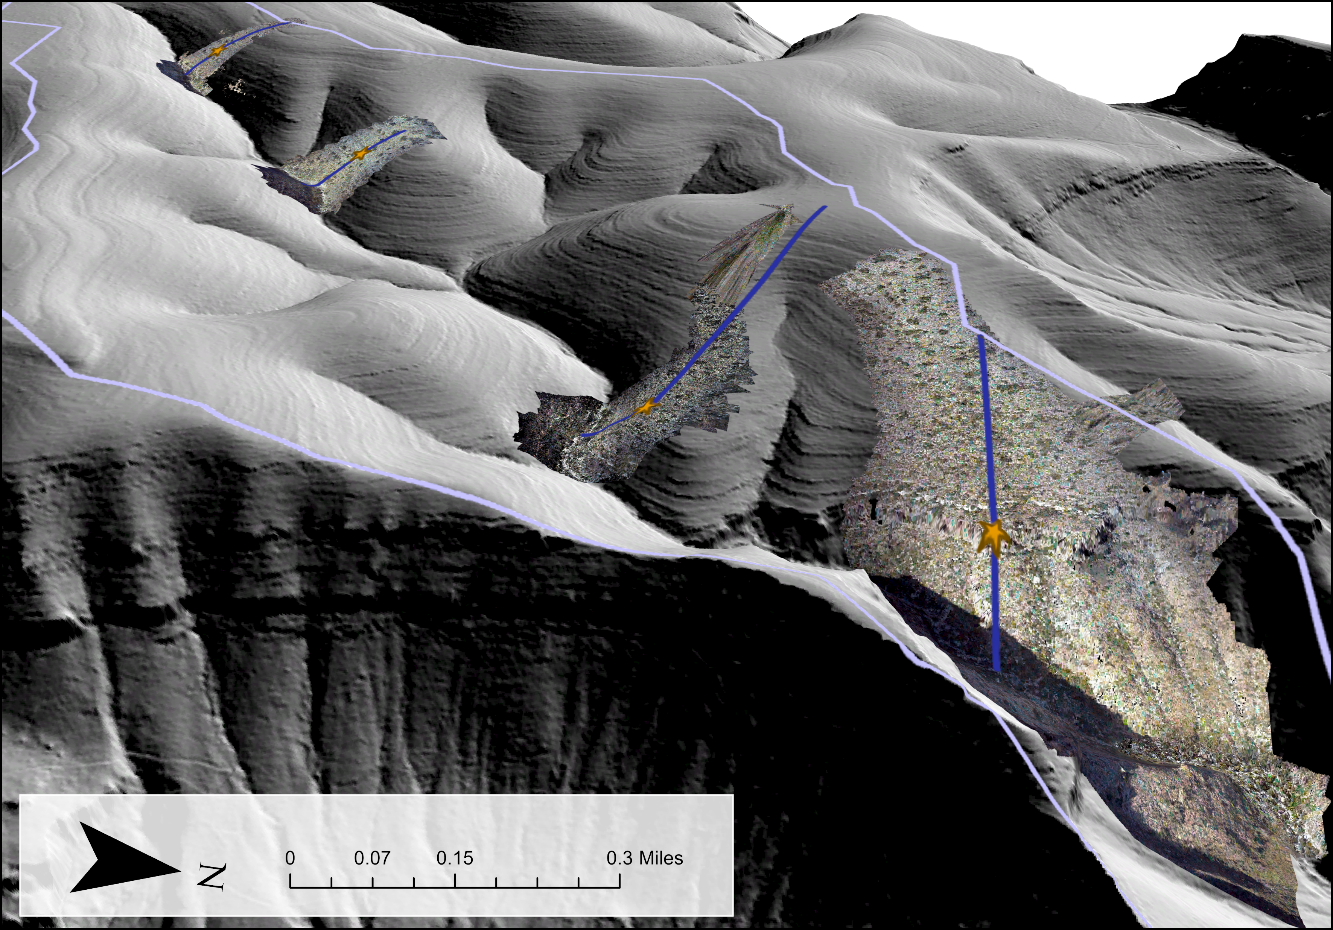

Slide 11
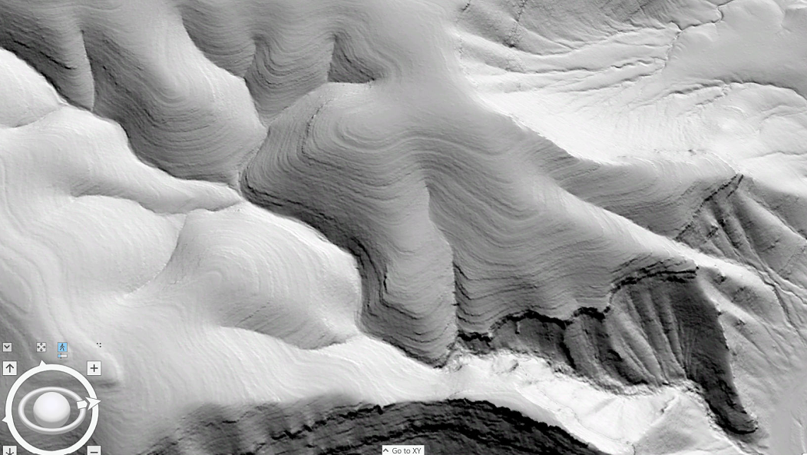
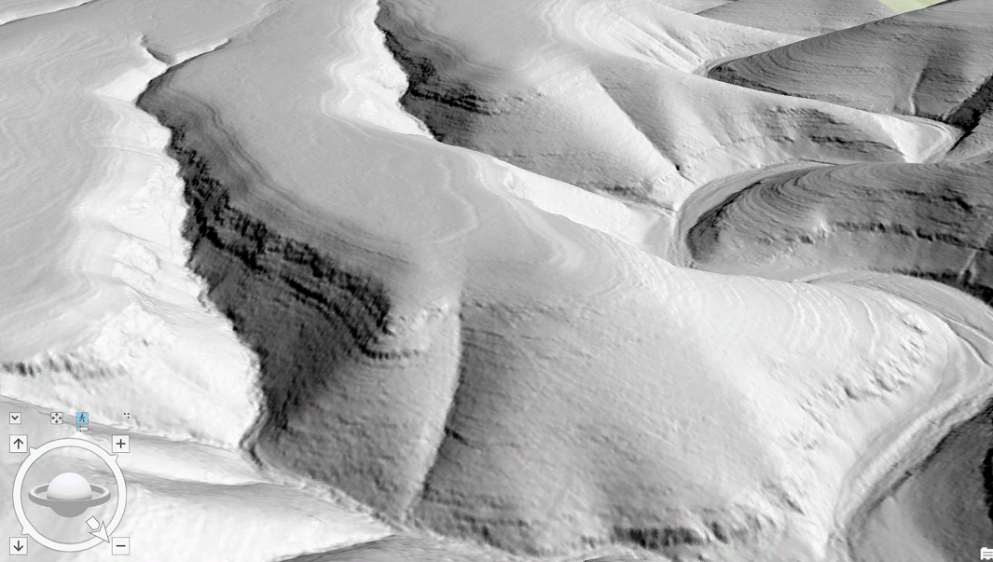



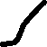
Elevation
distance

Slide 13
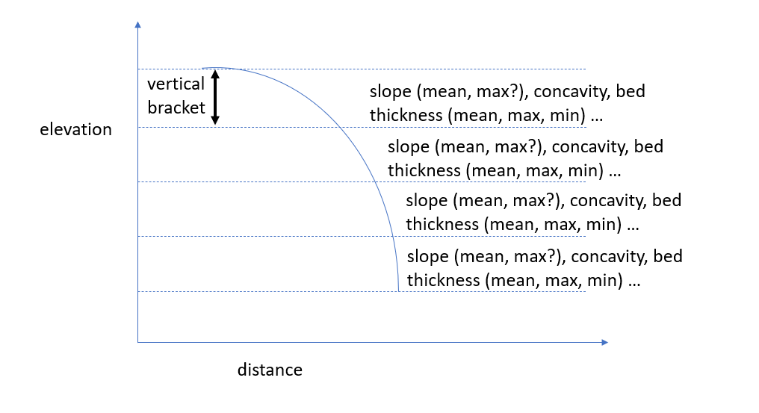

Slide 14
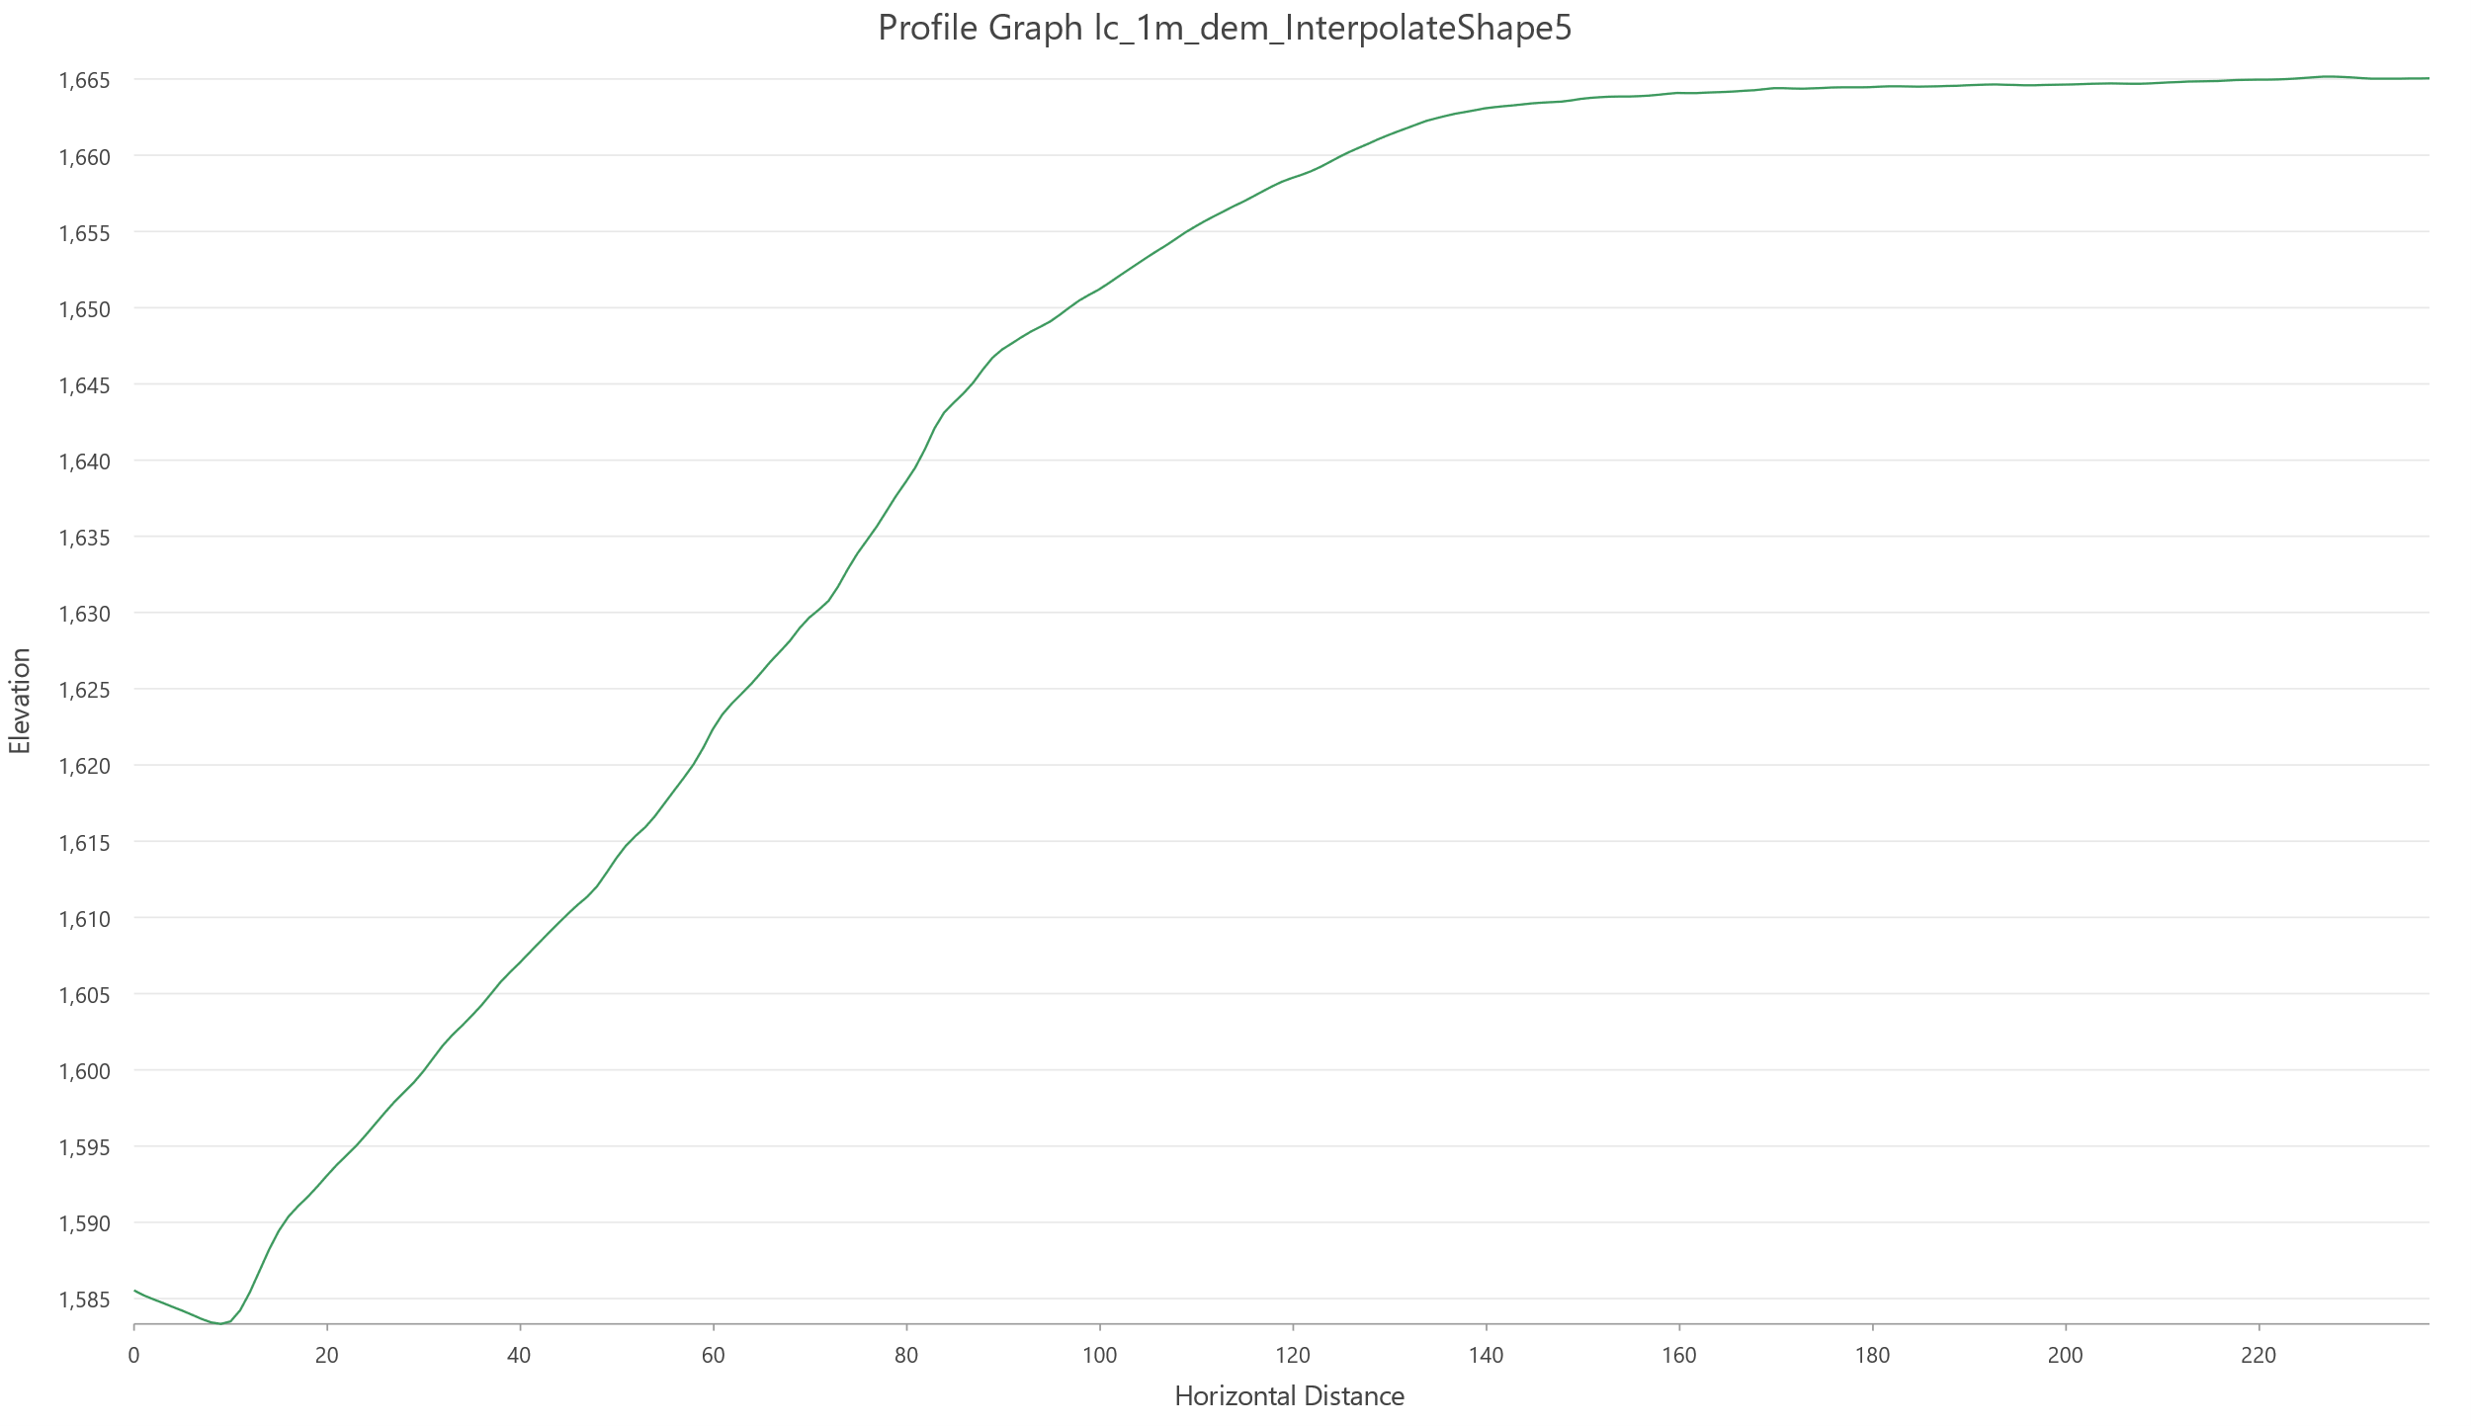
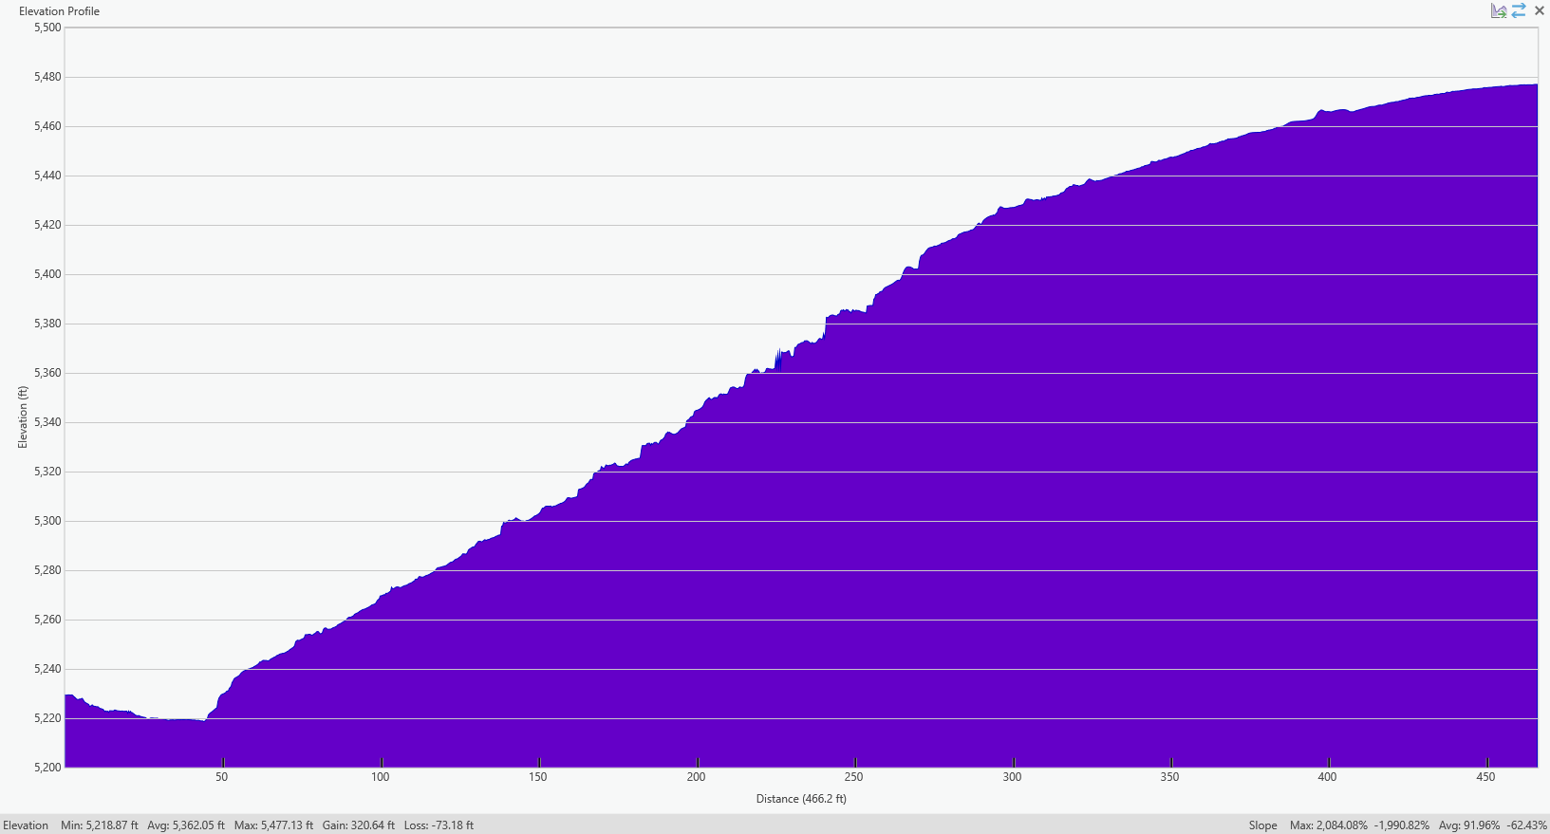

Slide 15
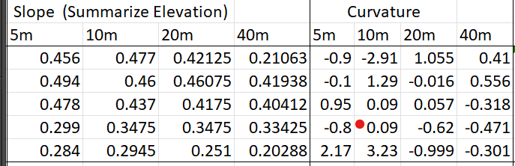
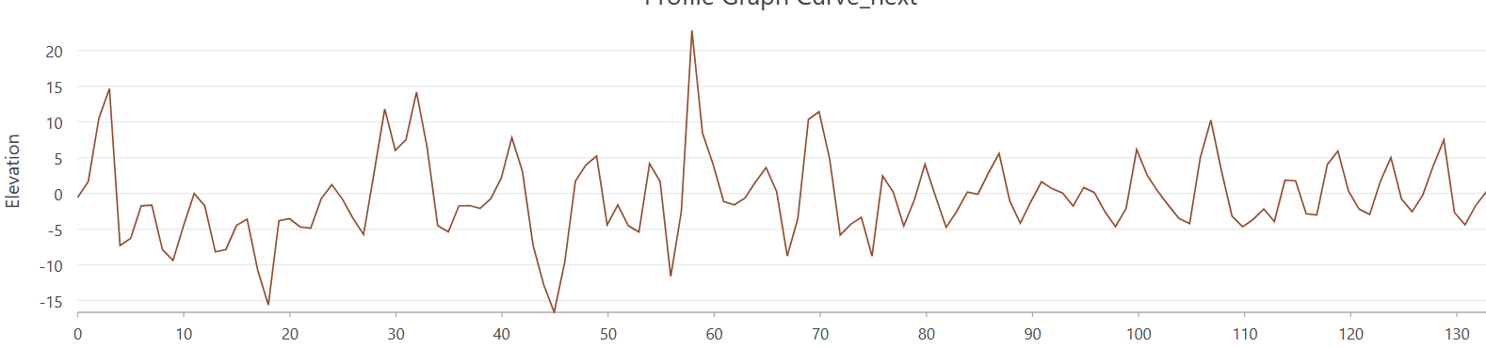

Slide 16
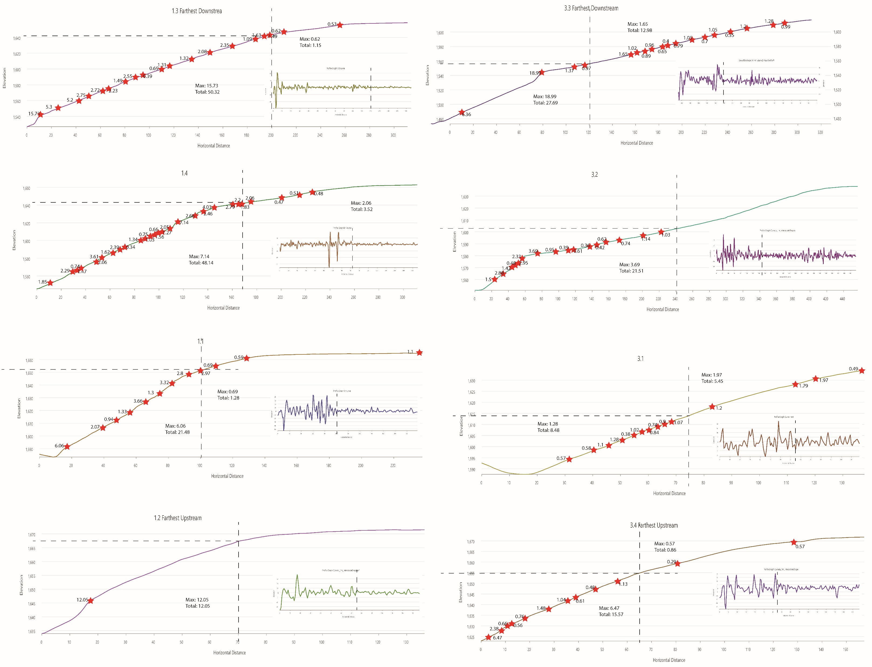

Slide 17
slope

Slide 18
elevation

Slide 19
curvature

Slide 22
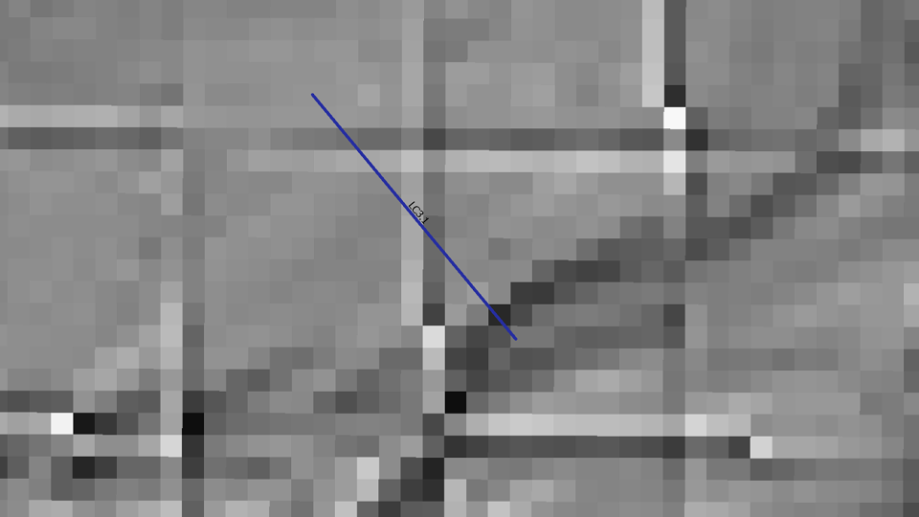

Slide 23
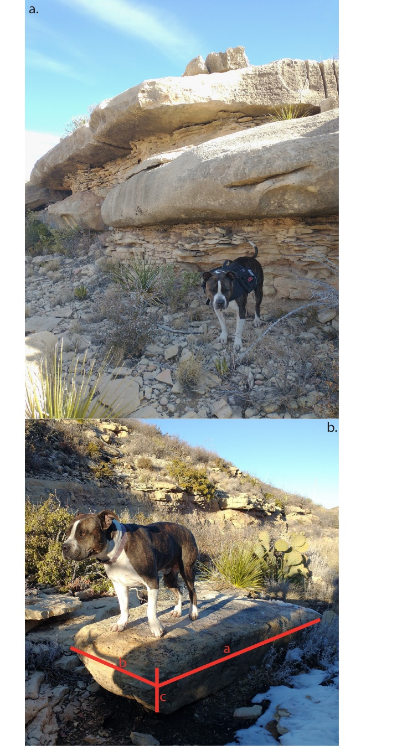
INTRO Figure : Field photos showing a) exposed beds of varying thicknesses and b) a boulder in the channel with dimensions reflective of proximal exposed bedrock.

Slide 24
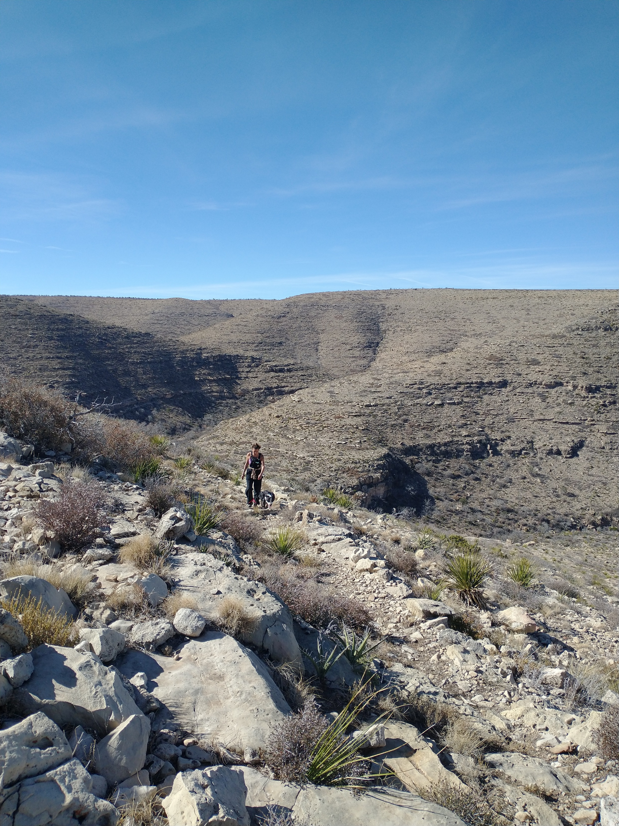
INTRO Figure : Field photo highlighting the steep downstream and shallow upstream hillslopes.

Slide 25
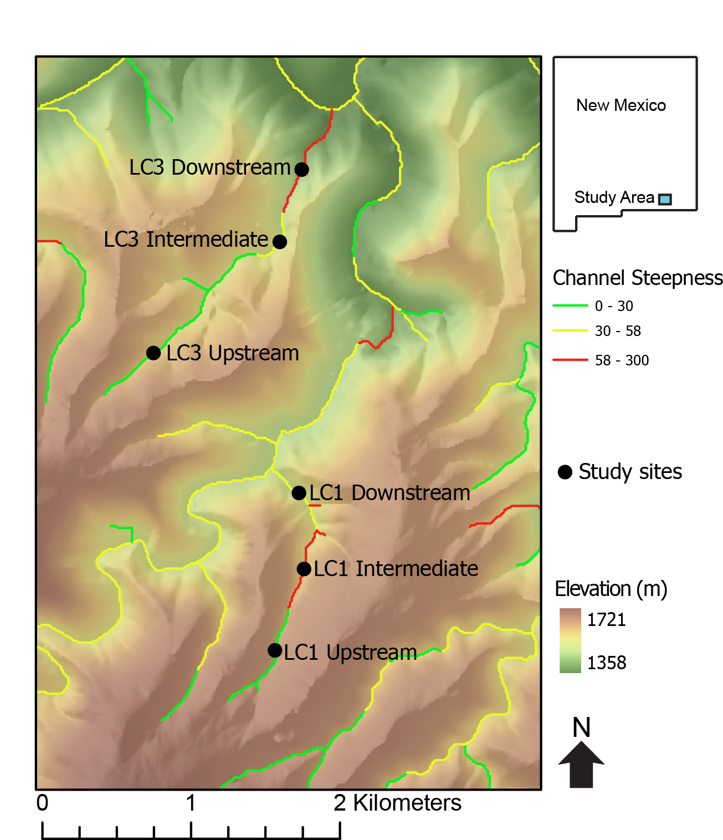
Figure : Topographic map superimposed on a hillshade of Last Chance canyon with ephemeral stream channels. Main stem of channel colored black with arrow indicating the direction of stream flow. The seven hillslope transects in the two different watersheds shown here.
Notes: split into two figures
One with the two watersheds highlighted
No ksn
Second with the transects and Ksns
Maybe break up more detailed map into wtersheds
Other LC3 Upstream

Slide 26
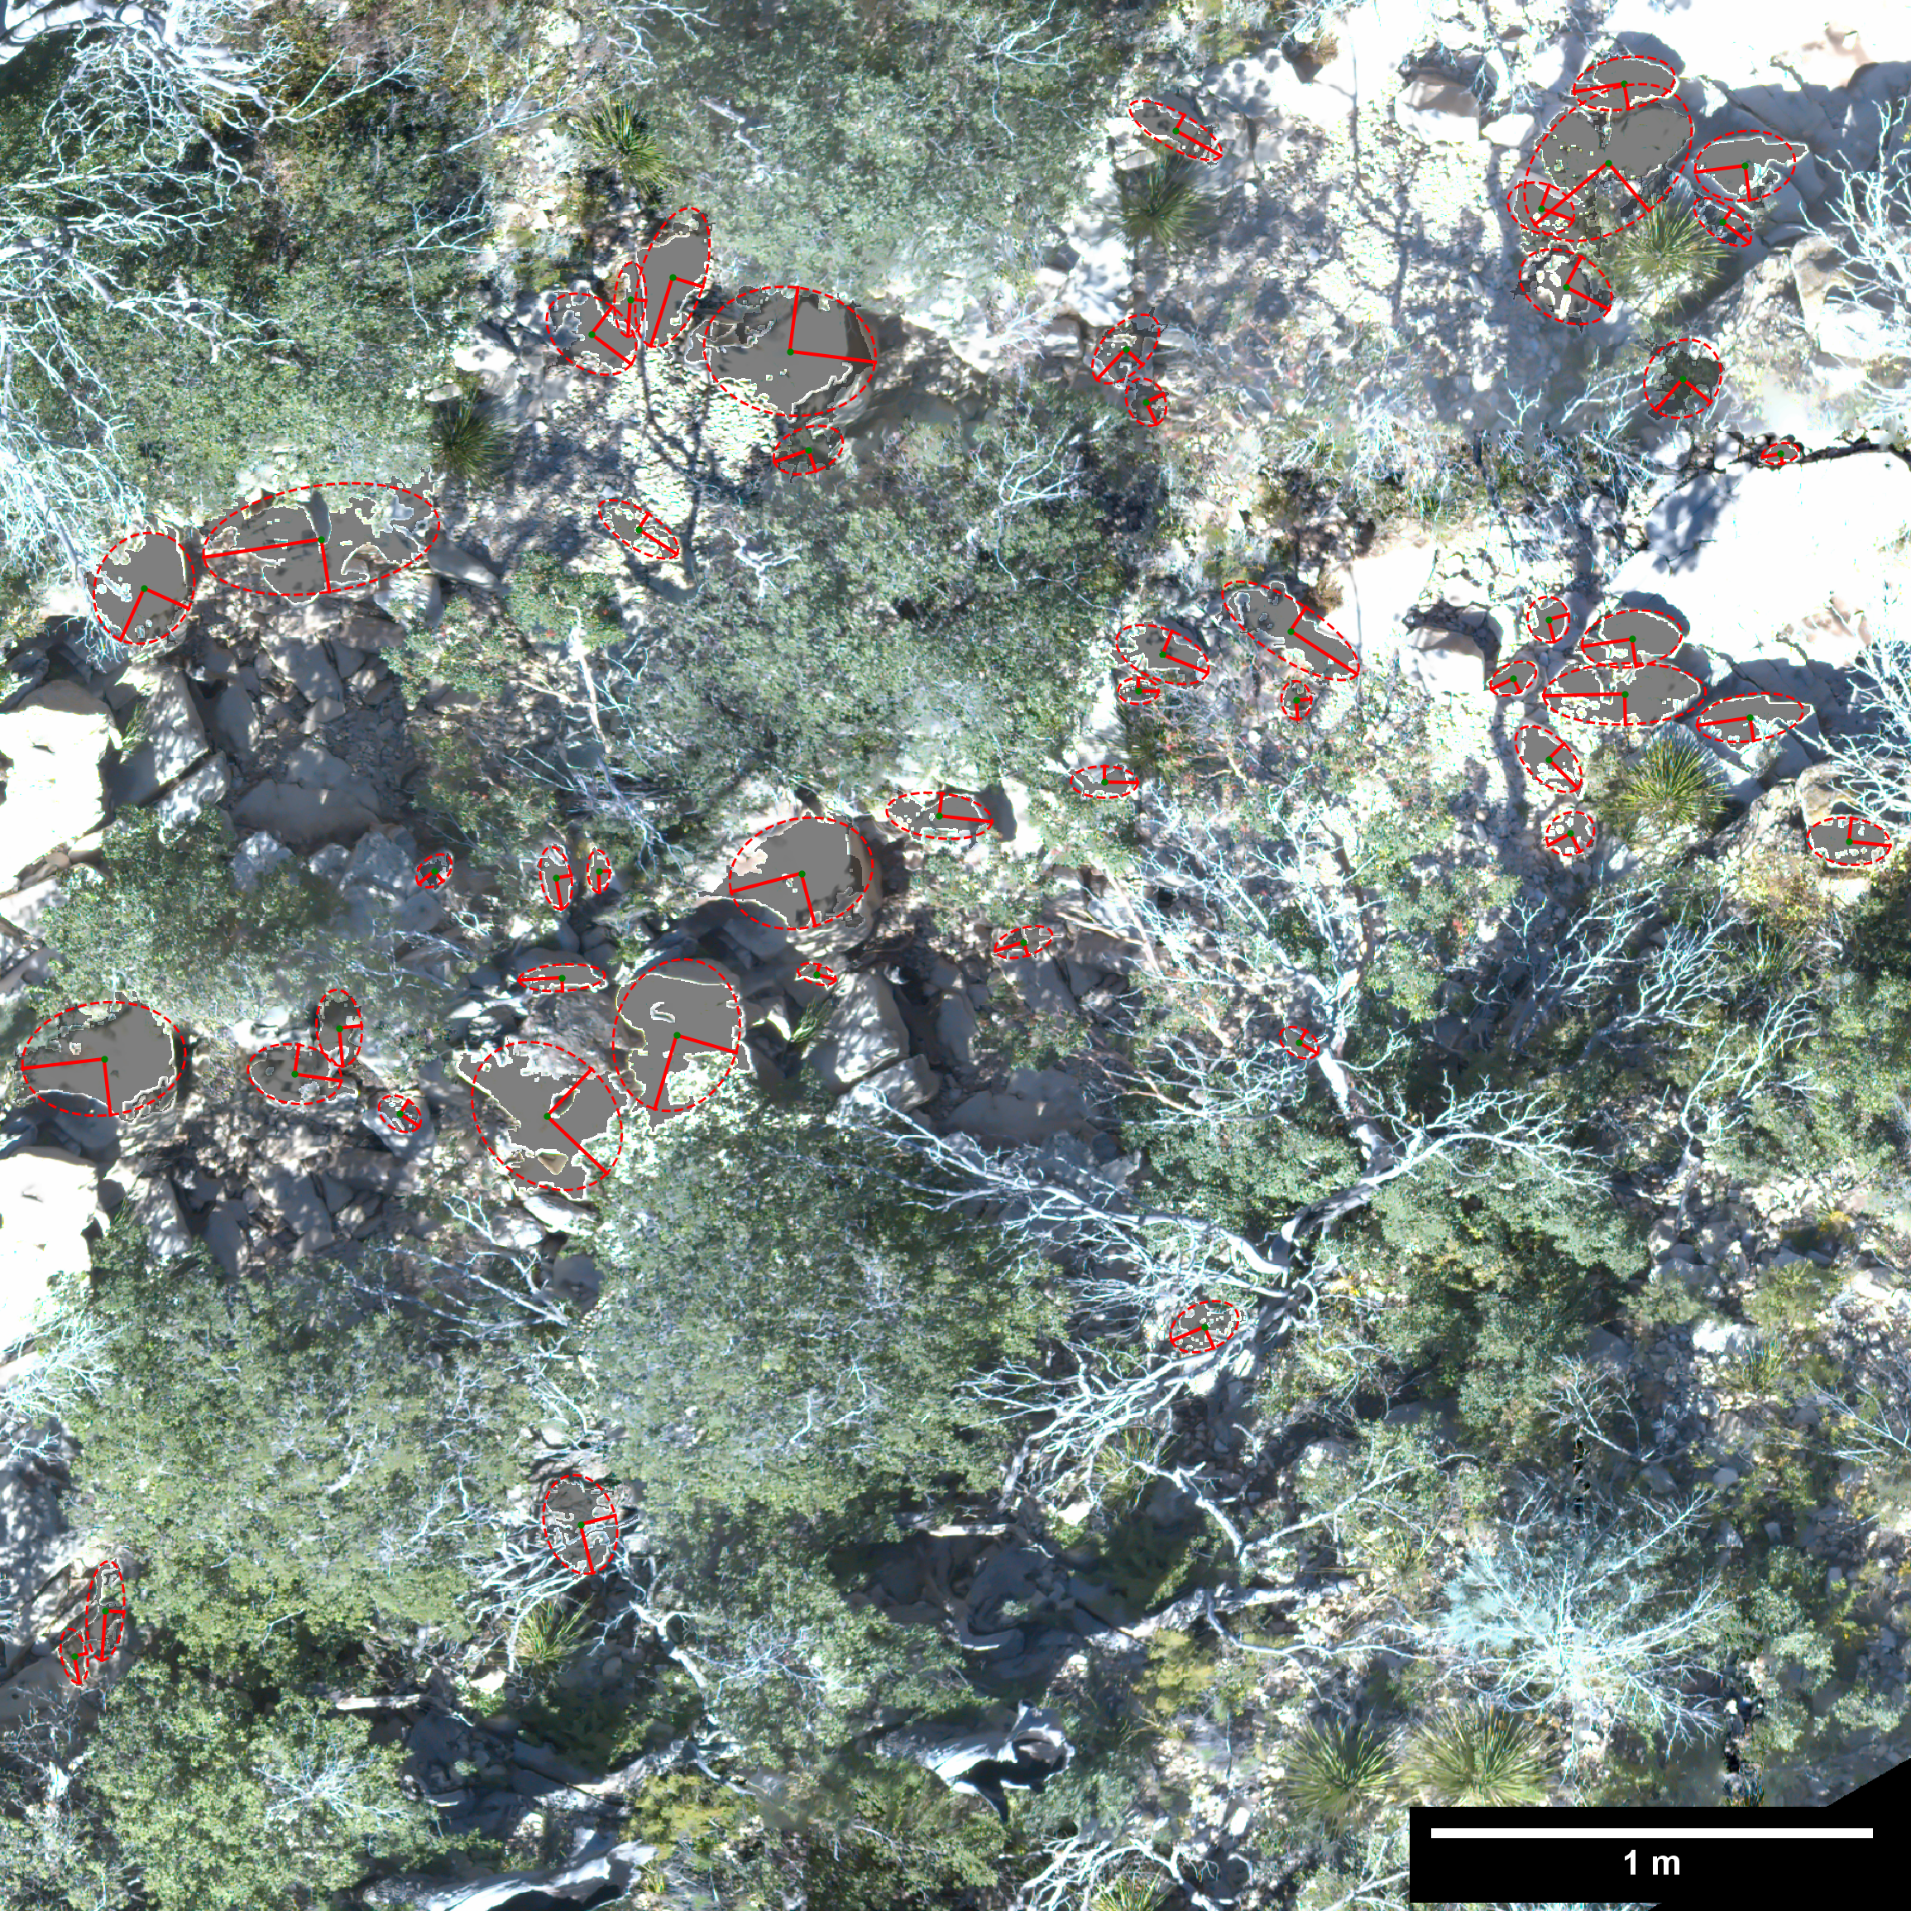
THIS ONE MAY BE DELETED
Figure : Orthomosiac illustrating the photosieving methodology used to measure sediment sizes in stream channels below the seven hillslope transects. Each measured sediment grain has an ellipse with the a (longer) and b axis (shorter) shown.
THIS PHOTO SUCKS. MAKE OWN PHOTO SIEVE FIG

Slide 27
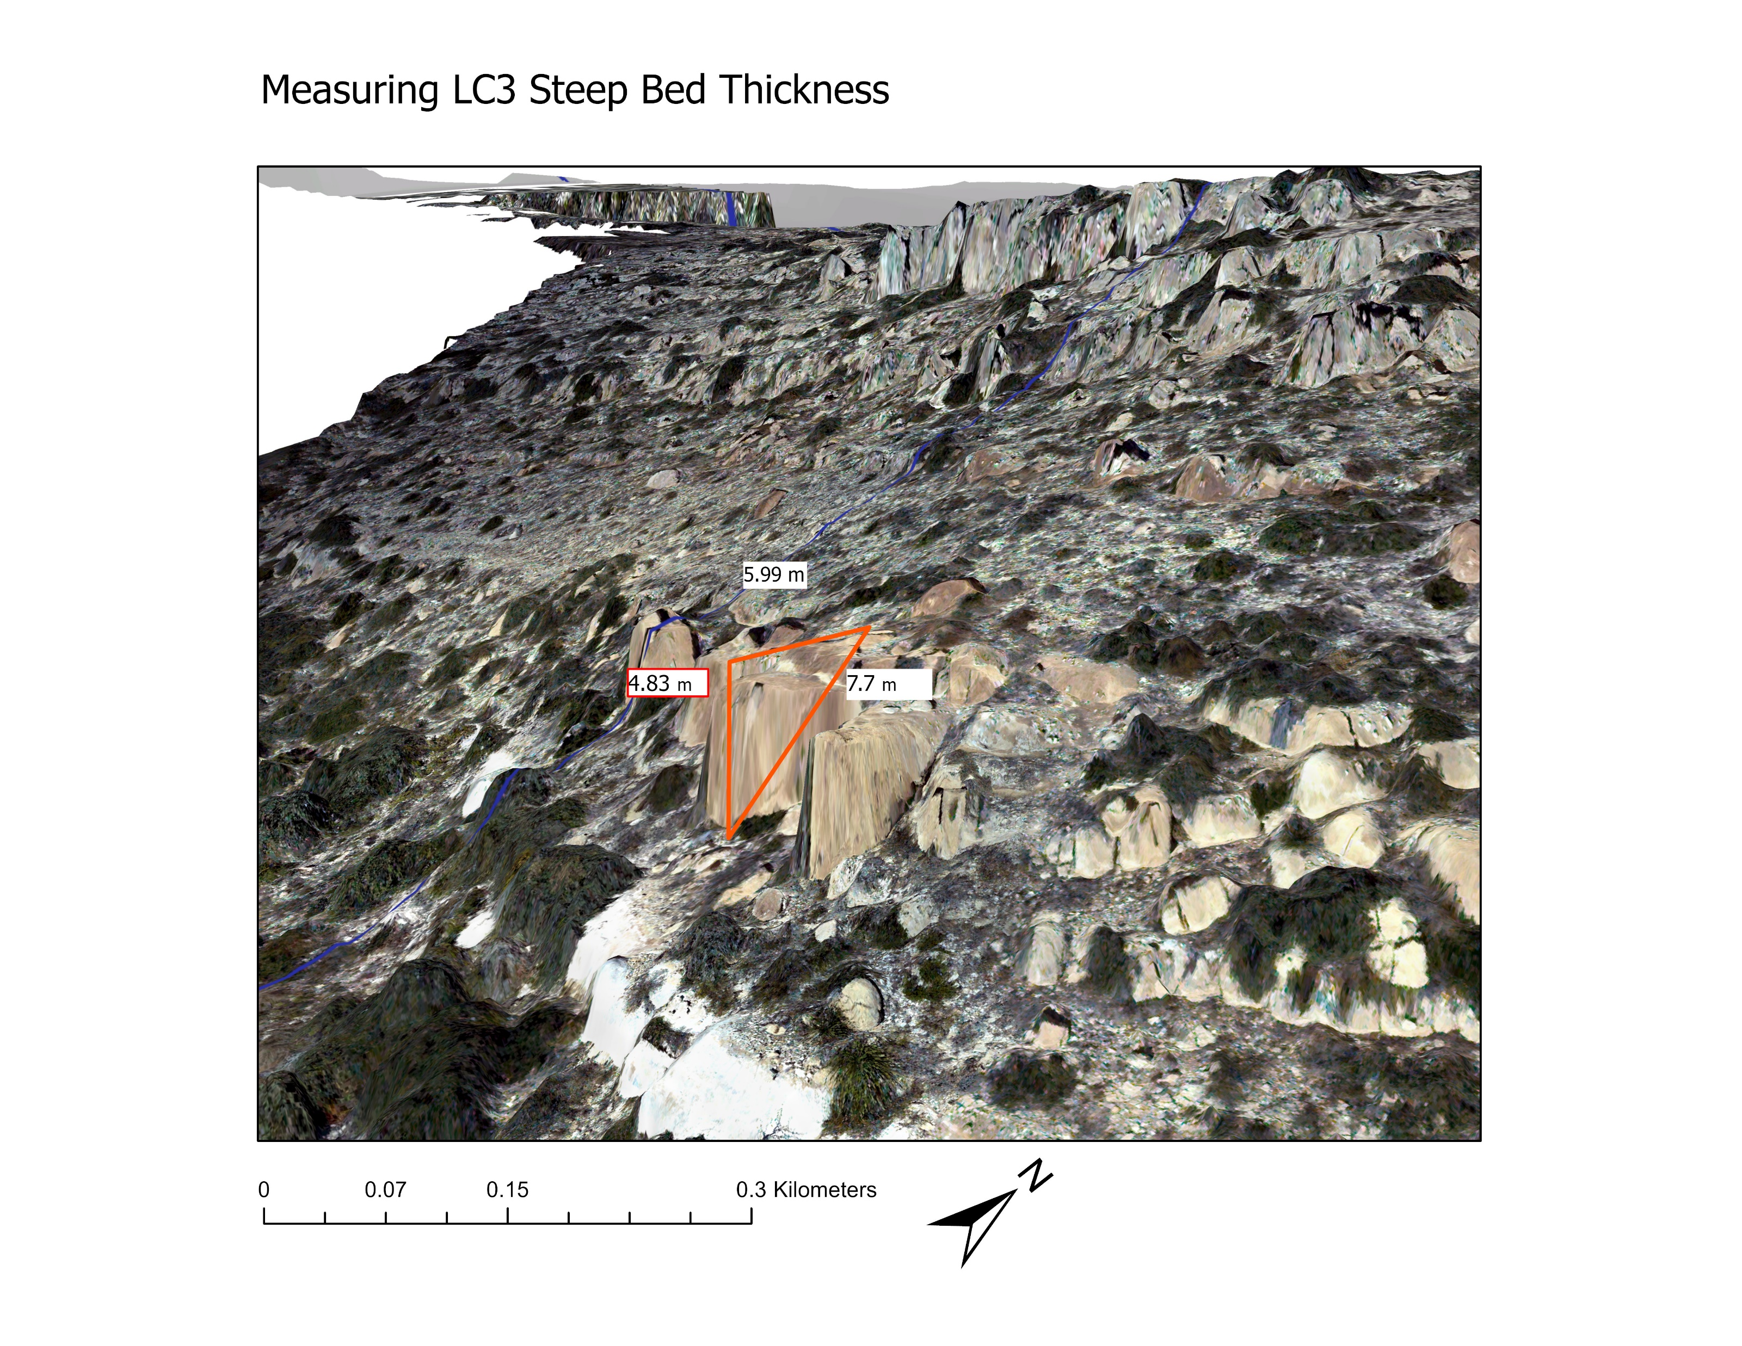
THIS MAY BE DELETED Figure : photo in arcscene illustrating the methodology used to measure beds on hillslopes.
DOUBLE CHECK THE SCALE BAR

Slide 28
Make ksn map, chi plots, show sed size in channels, and bed thicknesses on HS, include this

Slide 30
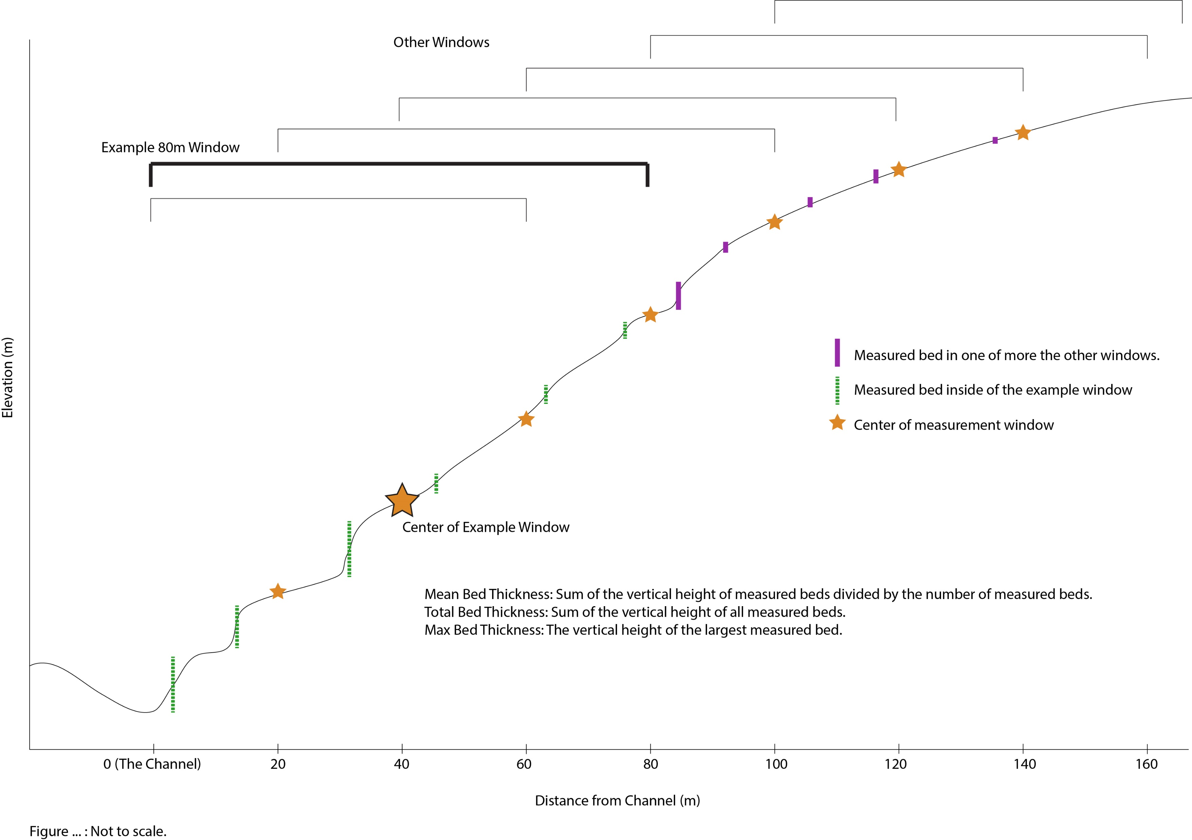
Figure : Schematic (not to scale) demonstrating the 80m window over which both slope and curvature were measured. Note that the 80m window shrinks at the edges of the transect so that data is taken from only the hillslope in question.

Slide 31
Figure : Figure showing the control bed thickness has on slope. Data for both slope and bed thickness are taken over an 80m window. Total thickness is all of the bed heights in he 80m window added together. Mean thickness is the average bed thickness in the window. Max thickness is the vertical distance of the largest bed in the window.

Slide 32
Figure : Bed thicknesses over the entire hillslope transect vs. slope of the entire transect.

Slide 33
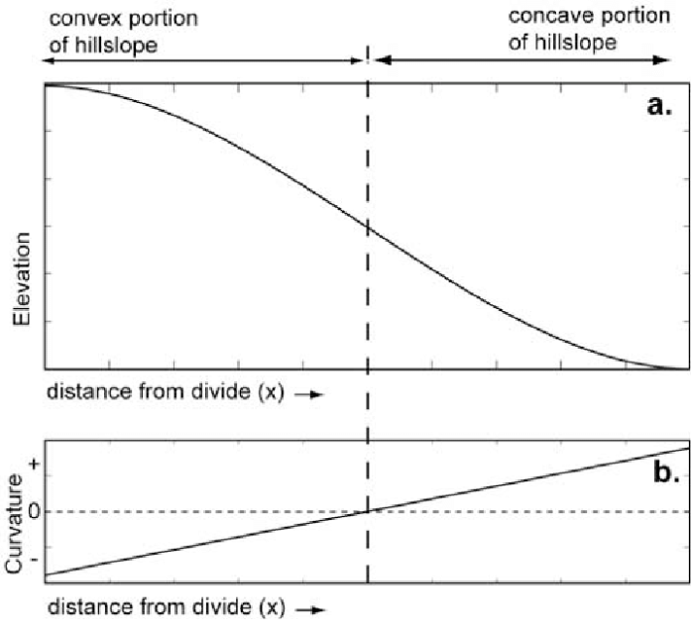
Figure : THIS FIGURE IS UNDER CONSTRUCTION I WANT TO SHOW HOW DIFFUSIVITY CHANGES WITH BED THICKNESS.
a) An idealized hillslope that shows curvature going from positive to negative as distance from channel increases. b) Shallow hillslope transect in LC3 that resembles the diffusive hillslope in a). Max bed thicknesses over each of the seven transects vs c) the slope of the distance vs curvature function and d) the r squared of the distance vs curvature function.

Slide 35
MAYBE PUT STEEPNESS AS A SECOND YAXIS
Figure : Bed thicknesses of the entire transect vs. a) average diameter of the b axis of alluvium in the channel below one of the seven hill slope transects and b) channel steepness (ksn) of the channel below each of the seven hill slope transects.

Slide 36
Figure : Bed thicknesses over the entire hillslope transect vs. channel steepness (ksn) of the channel below each of the seven hill slope transects.

Slide 37
Figure : THIS FIGURE IS UNDER CONSTRUCTION I WANT TO SHOW HOW DIFFUSIVITY CHANGES WITH BED THICKNESS.
LC1 is legit. It’s the most hillslopey and also large sediment appears as if its coming from near the channel.

Slide 41
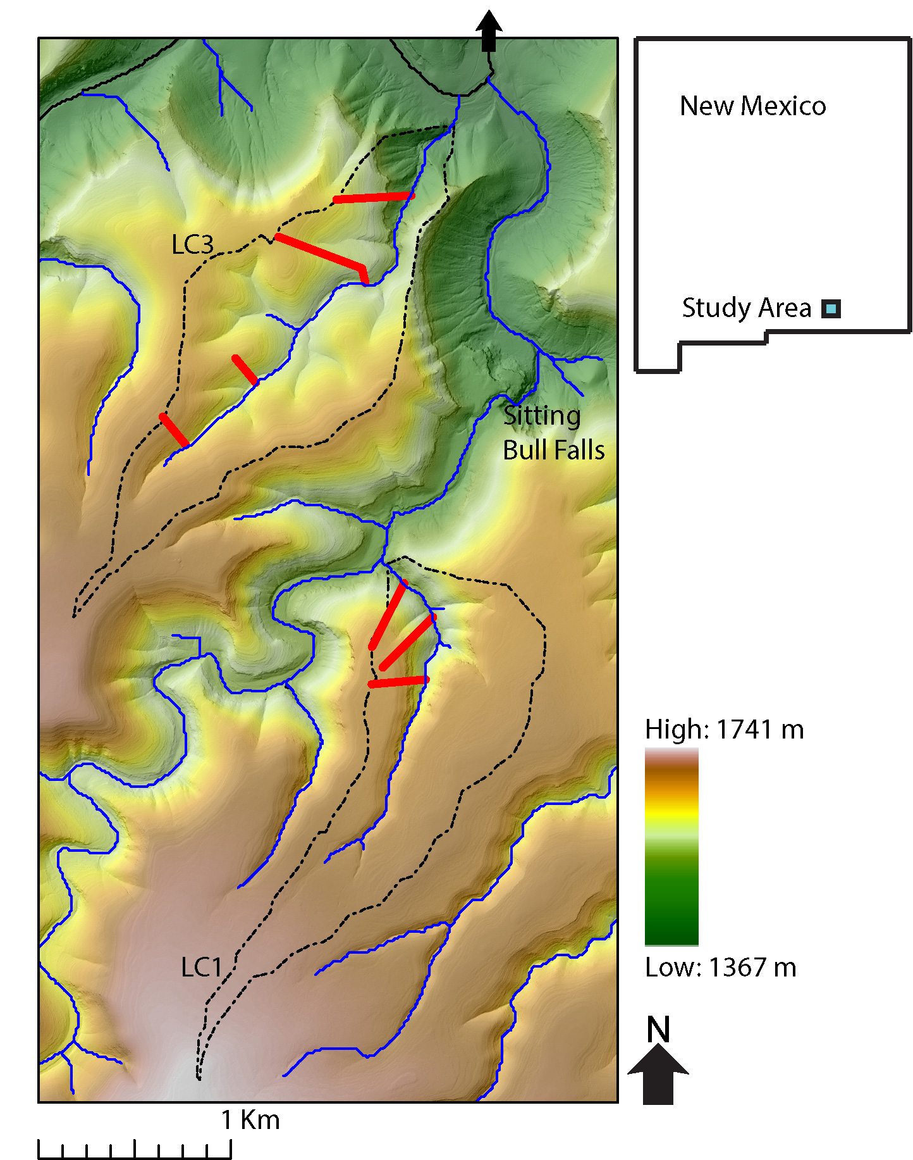

Slide 42
INTRO Figure : Field photo highlighting the steep downstream and shallow upstream hillslopes.

Slide 43
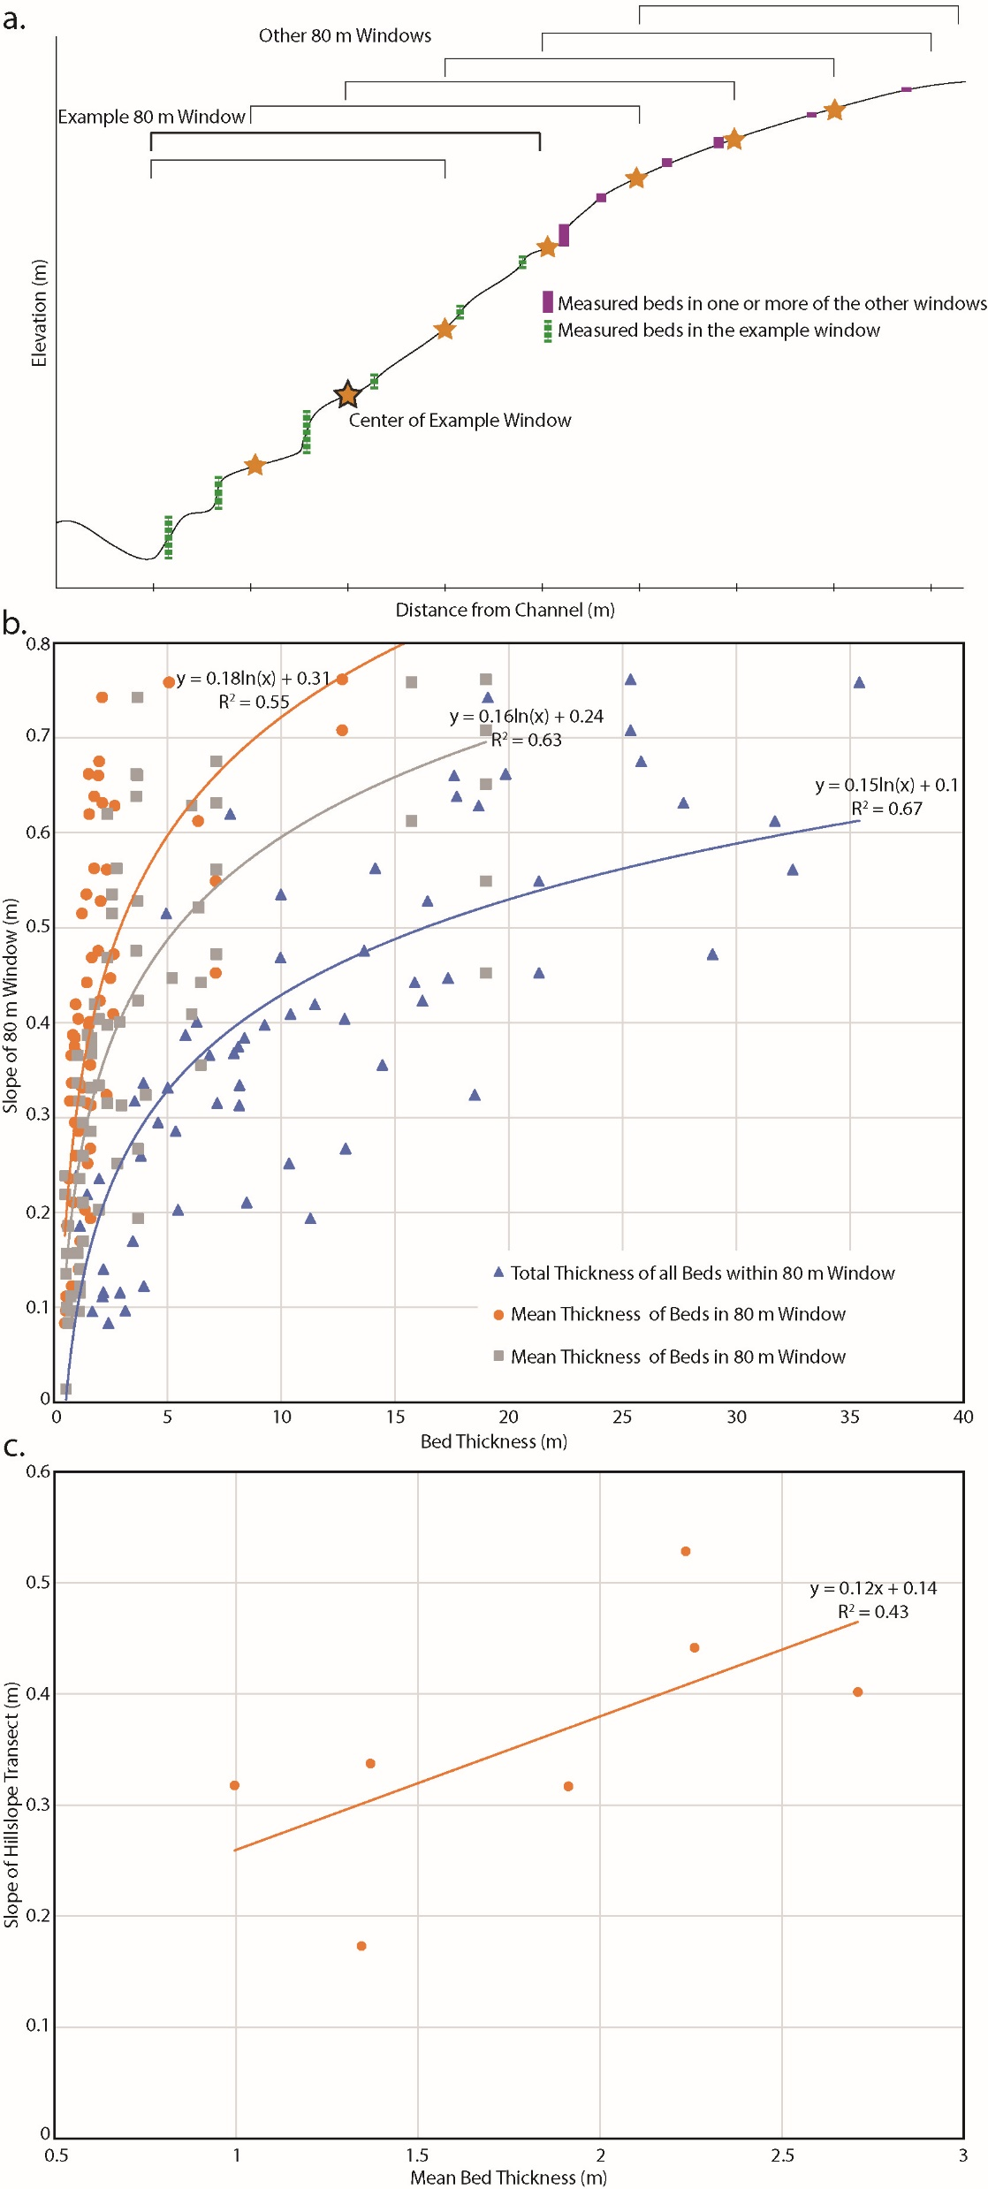

Slide 44
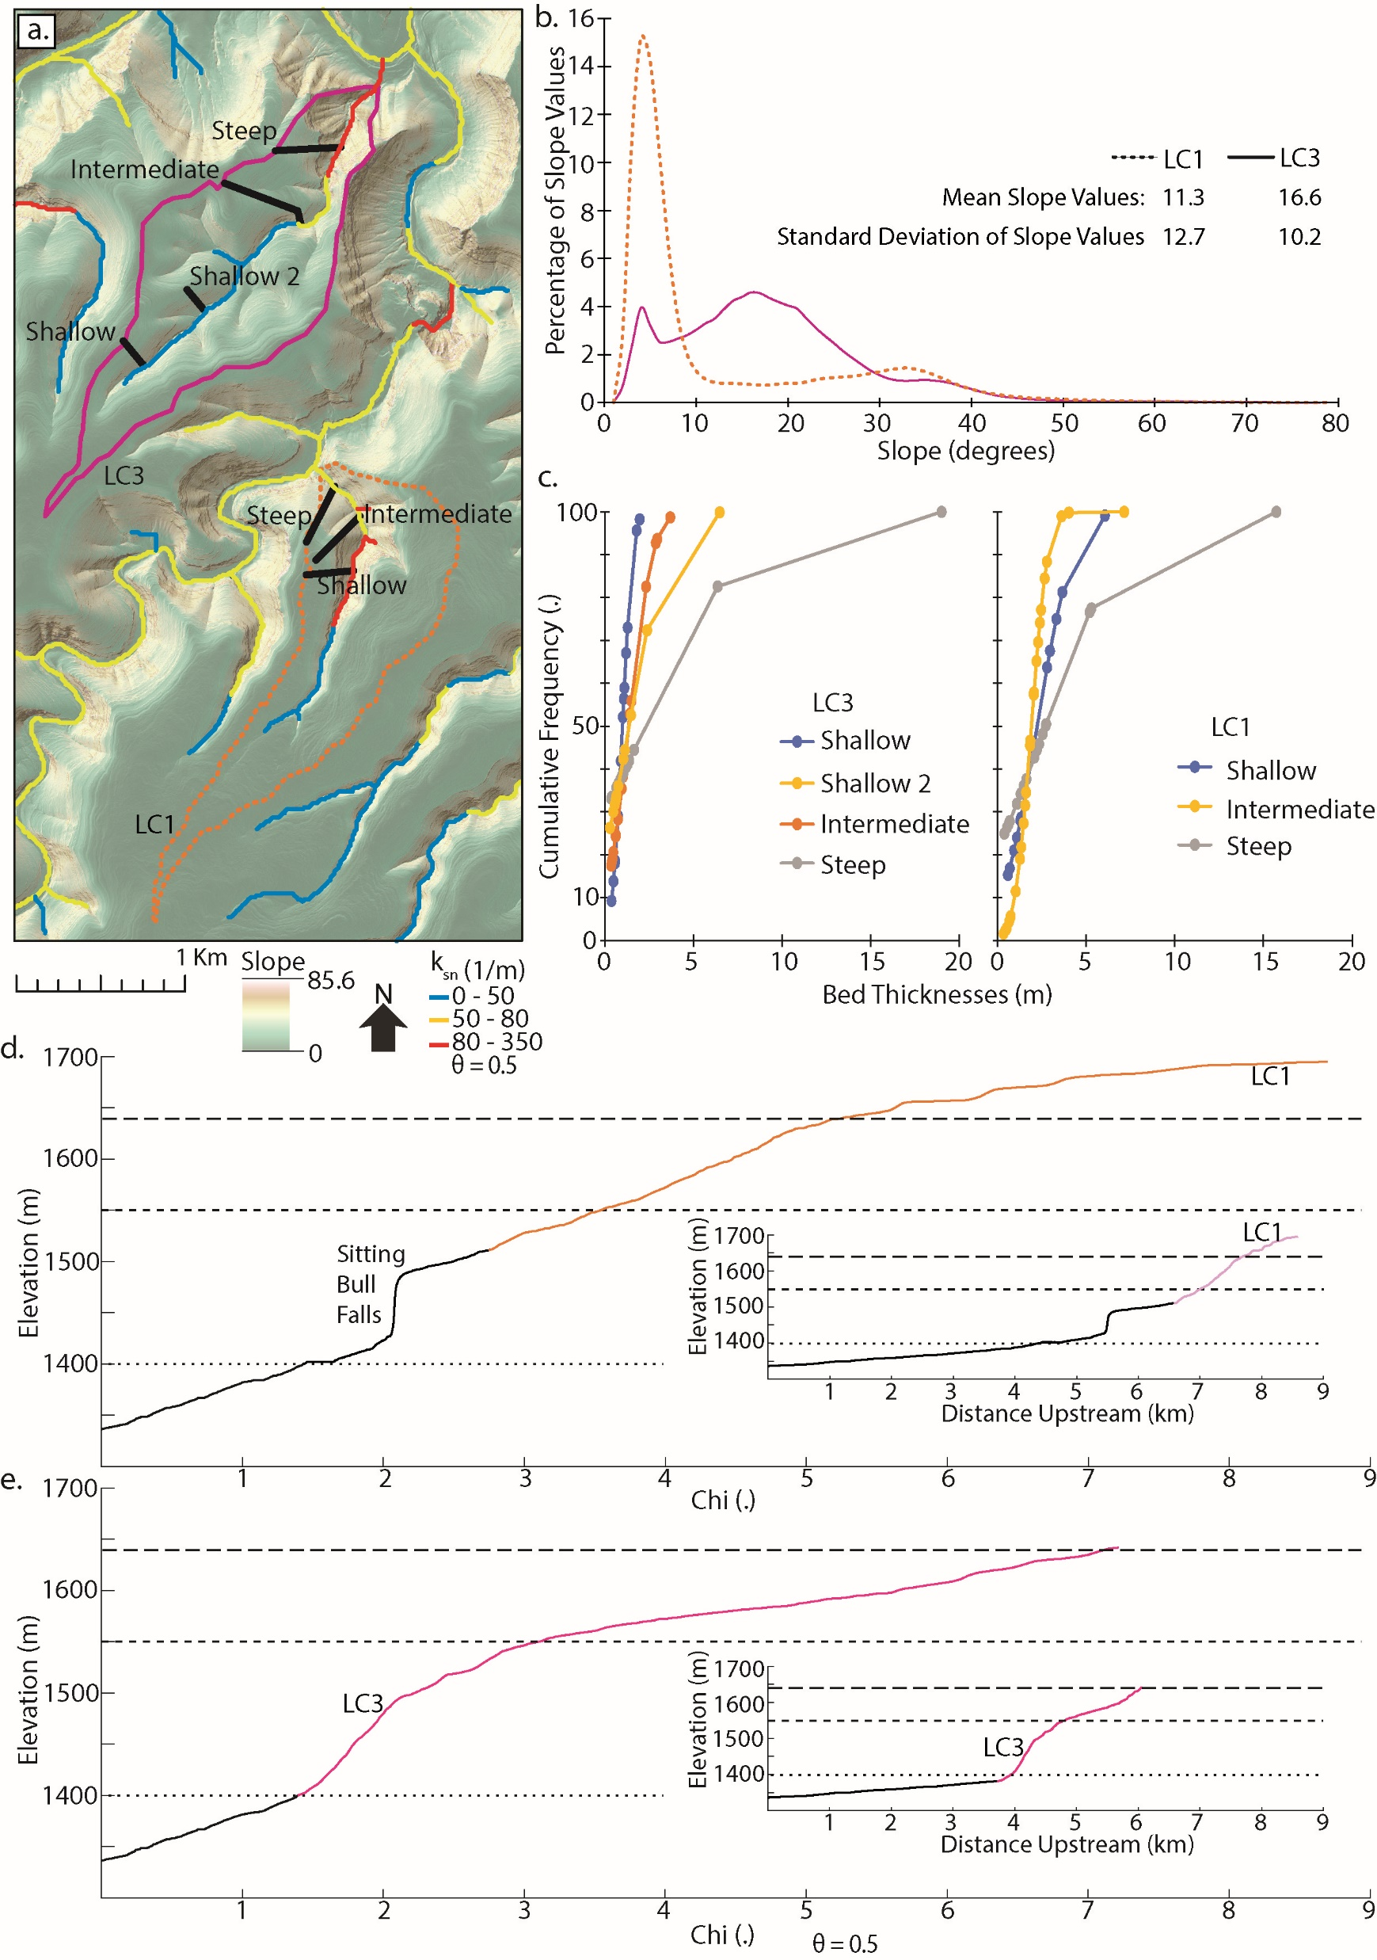
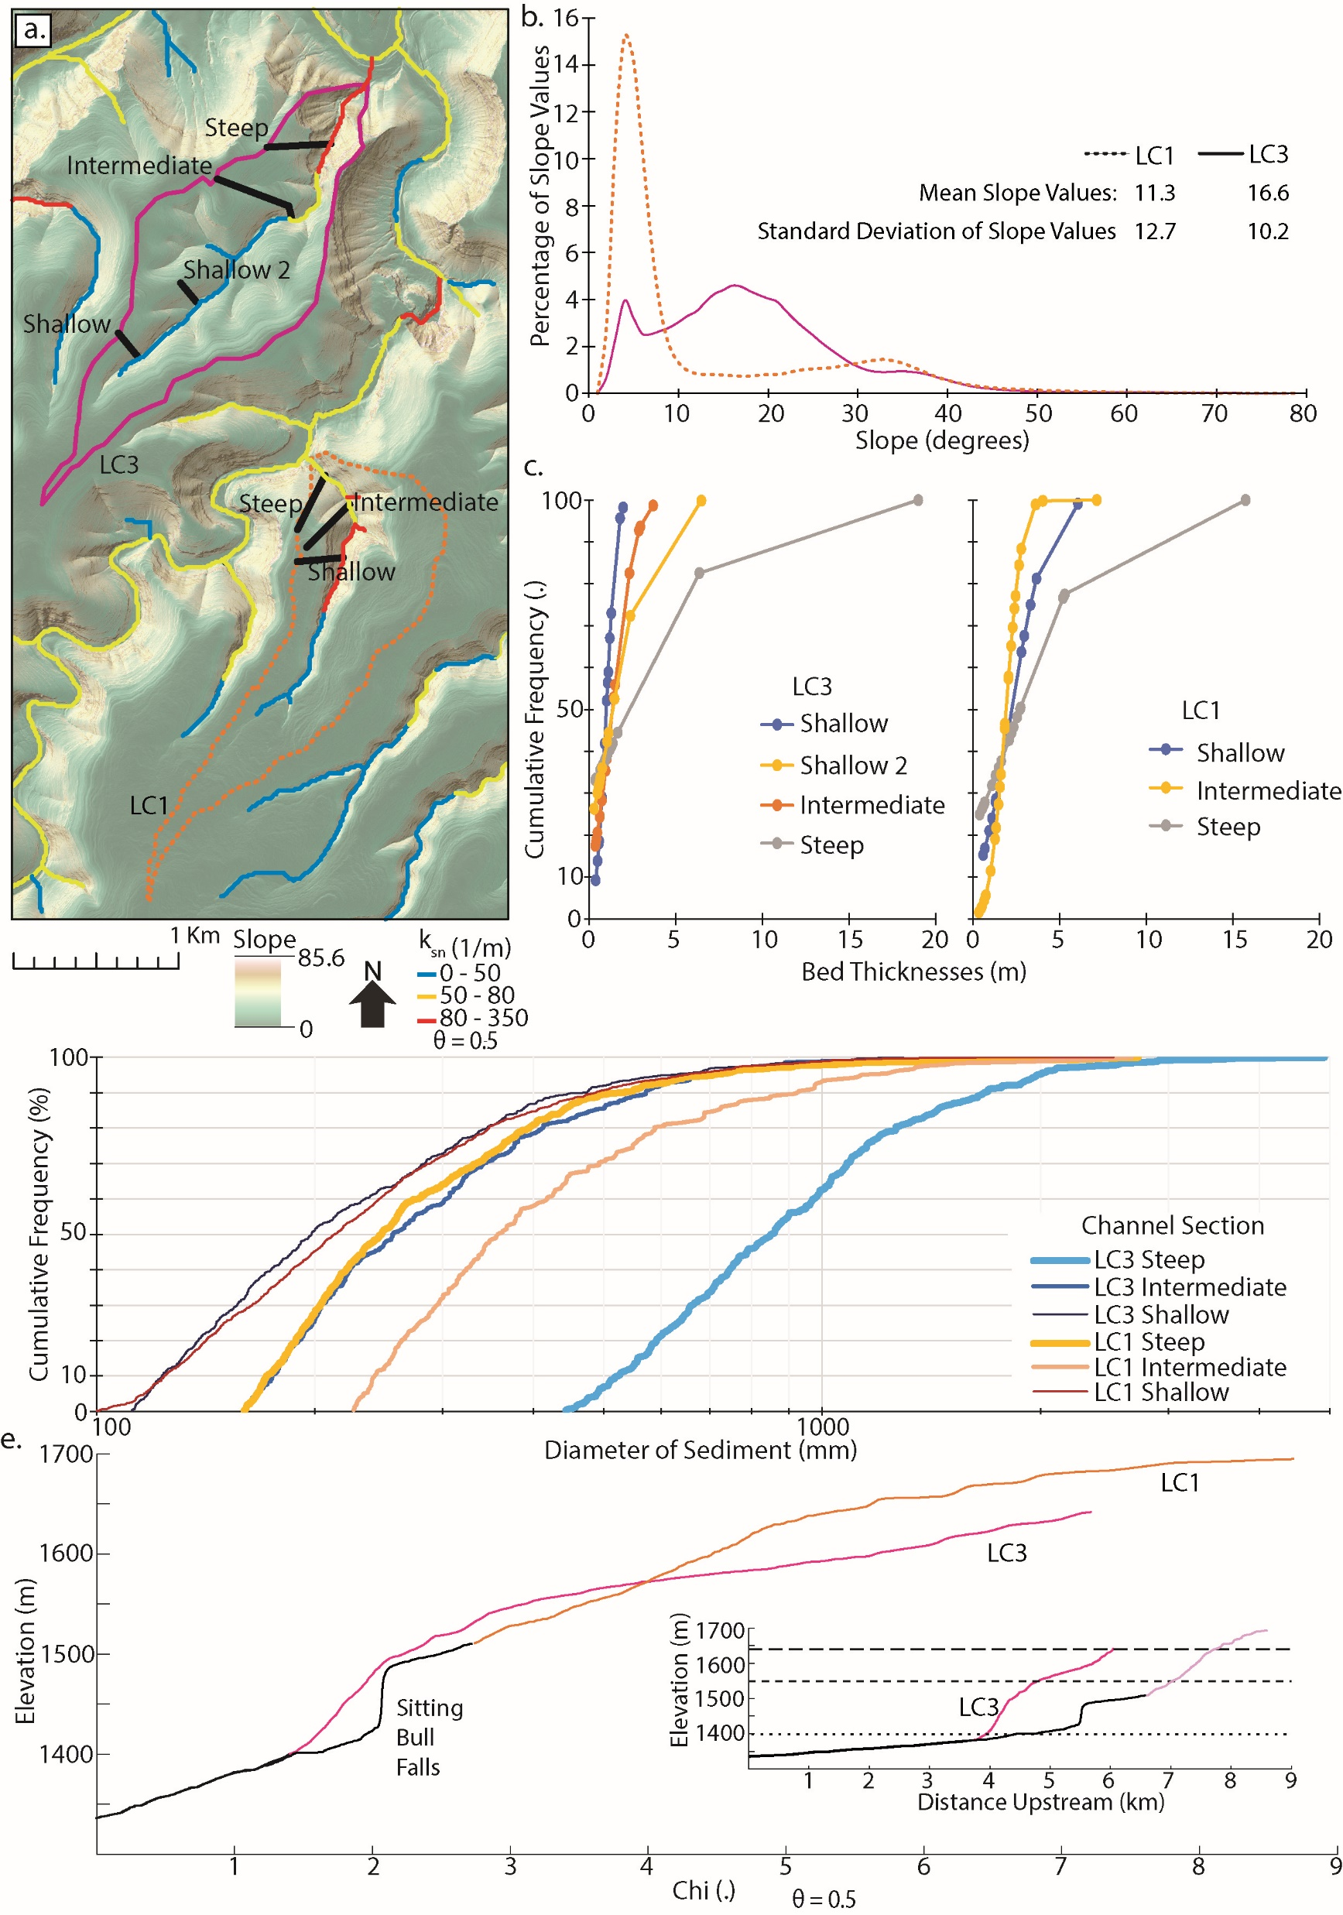

Slide 45
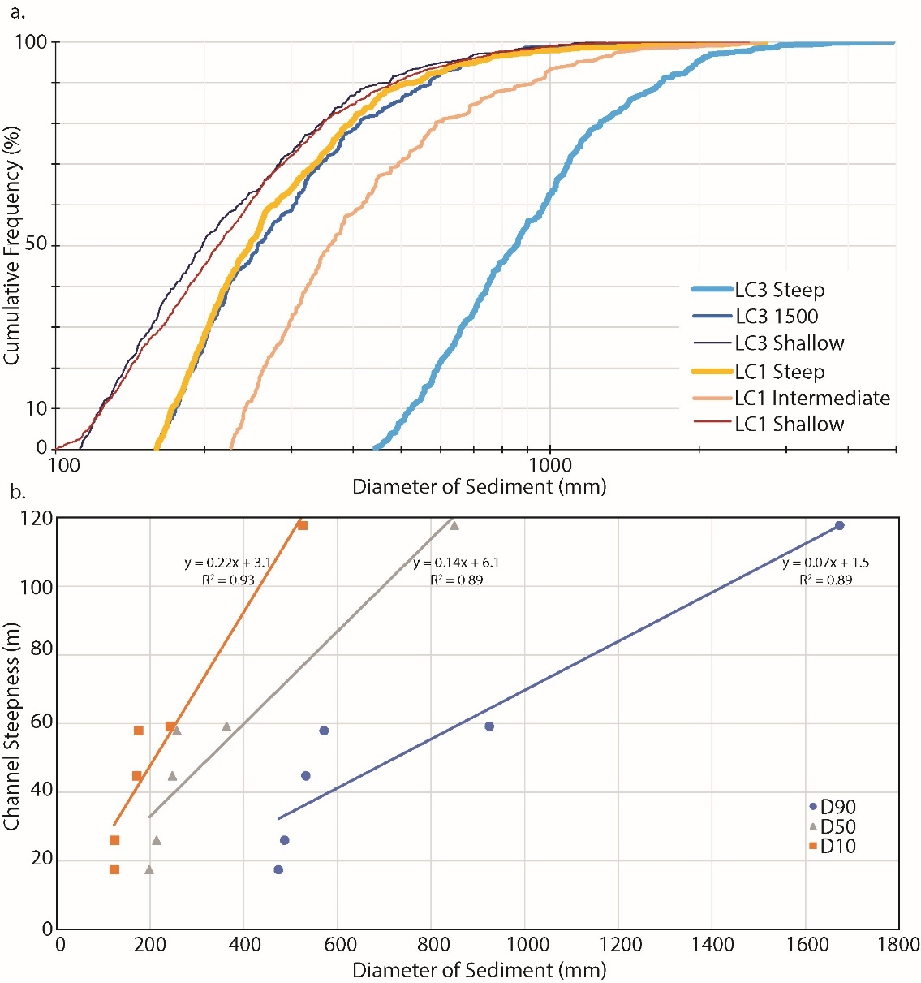

Slide 47
INTRO Figure : Field photos showing a) exposed beds of varying thicknesses and b) a boulder in the channel with dimensions reflective of proximal exposed bedrock.

Slide 49
Figure : THIS FIGURE IS UNDER CONSTRUCTION I WANT TO SHOW HOW DIFFUSIVITY CHANGES WITH BED THICKNESS.
a) An idealized hillslope that shows curvature going from positive to negative as distance from channel increases. b) Shallow hillslope transect in LC3 that resembles the diffusive hillslope in a).

